Slide 1
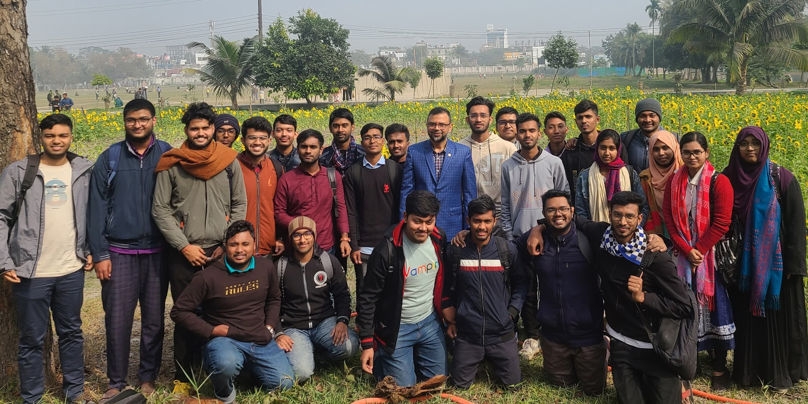
Student Details Management System
Efficiently Manage Student Records
(A JAVA GUI PROJECT)
Presented by Saiful Islam Reyad
Jannatul Ferdousi Riti
Md Mahfuzur Rahman

Slide 2

Introduction
Objective: The Student Management System aims to streamline the process of managing student records.
Functionality:
Add Student: Enter new student details and add them to the system.
Update Student: Modify existing student details.
Delete Student: Remove a student from the system.
Navigation: Move between student records using navigation buttons.
Sorting: Sort student records based on ID for easy access.

Slide 3

Components
Text Fields: Input fields for name, ID, address, etc.
Buttons: Add button, update button , delete button , navigate buttons, and sort button.
Labels: Name label, ID label, Address label, DisplayArea label
Panels: InputPanel, ButtonPanel

Slide 4
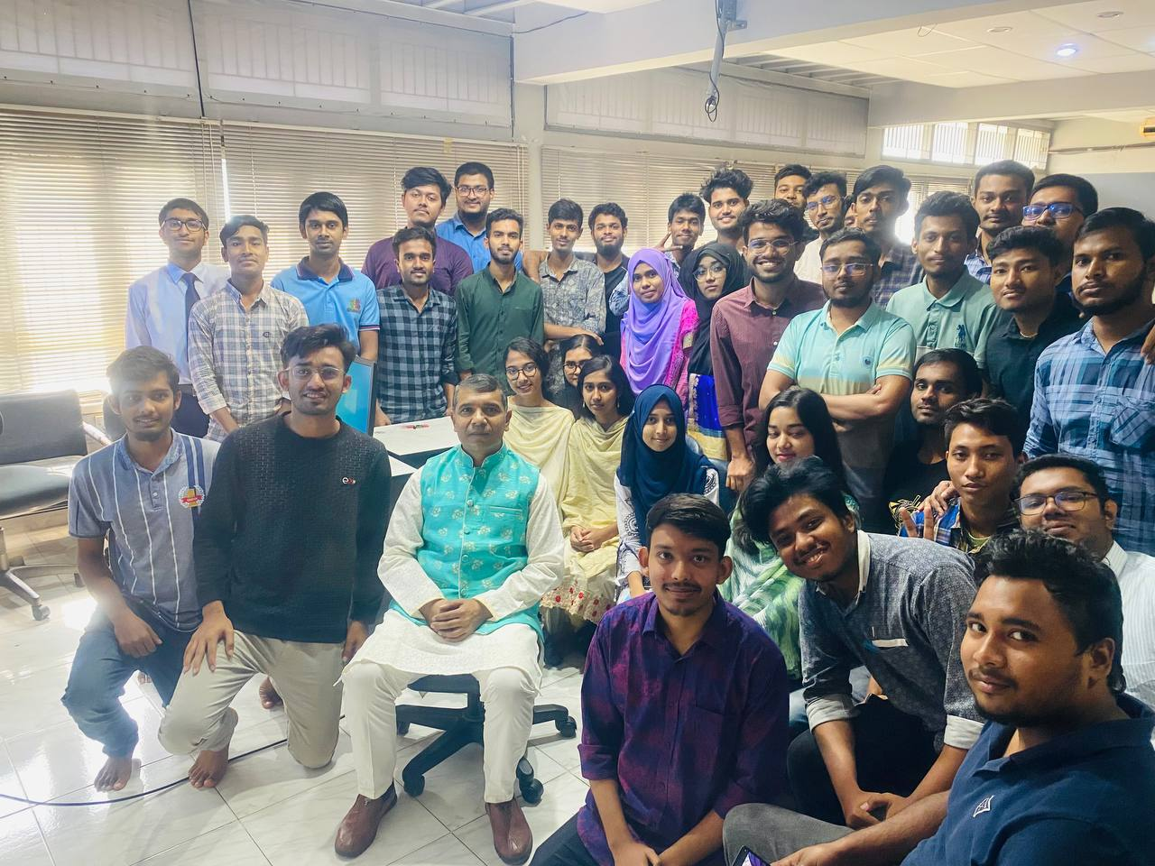
Benefits
Efficiency: Streamlines student record management tasks.
Accuracy: Helps maintain accurate and up-to-date student information.
Convenience: Easy navigation and sorting make it convenient to access student details.

Slide 5
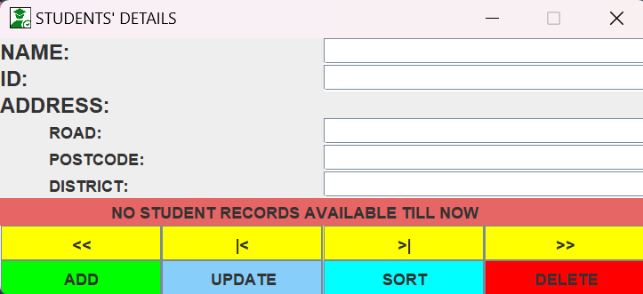
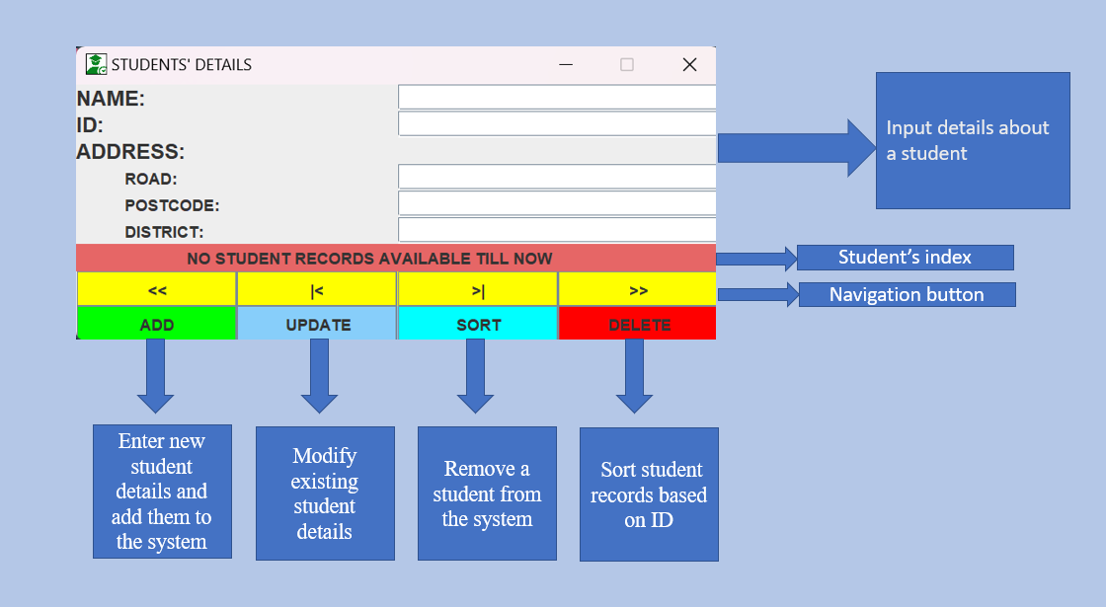
Visual Representation:
Input details about a student
Student’s index
Navigation button
Enter new student details and add them to the system
Modify existing student details
Remove a student from the system
Sort student records based on ID

Slide 6
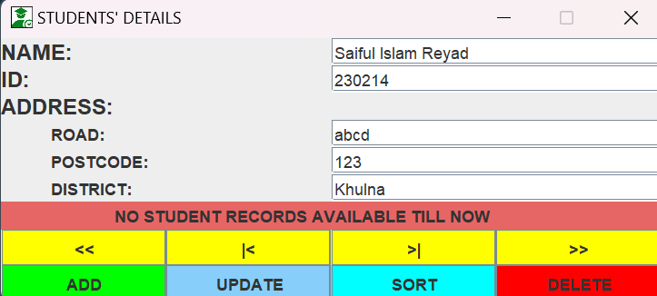
Visual Representation:

Slide 7
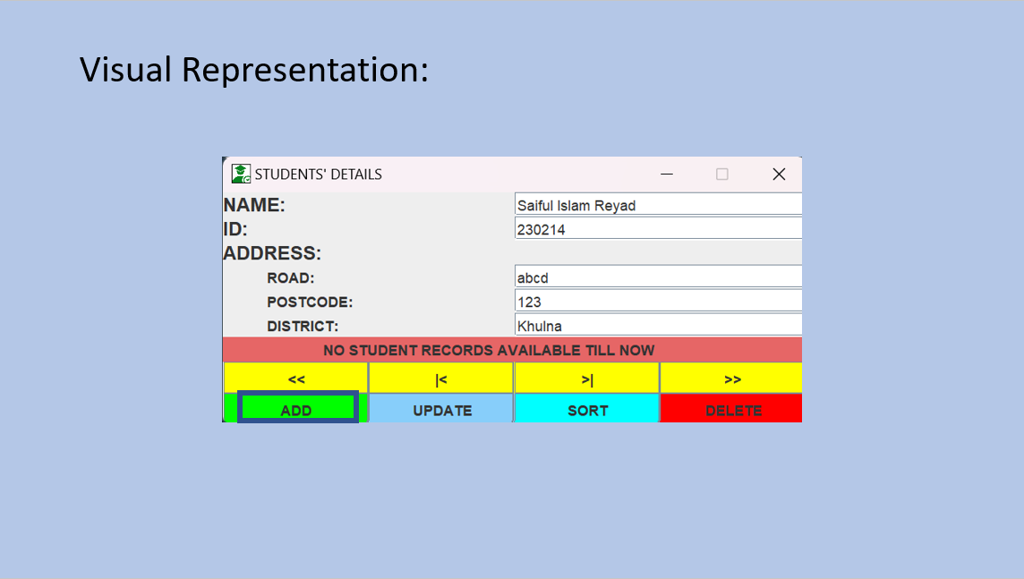
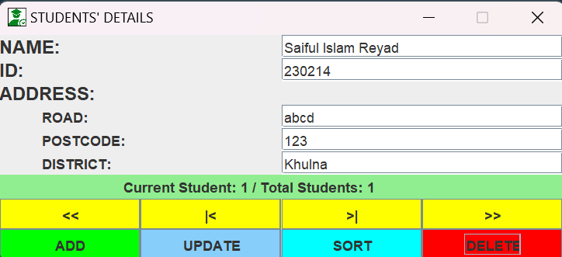

Slide 8
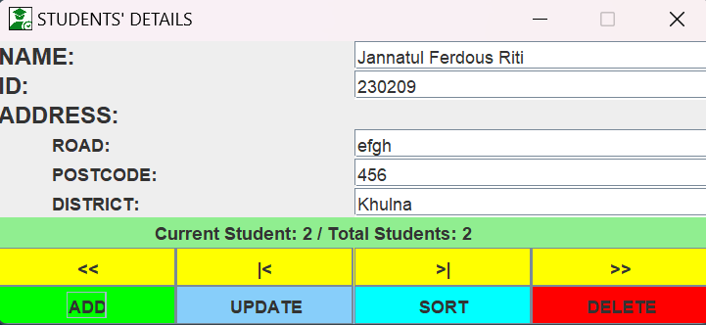


Slide 9
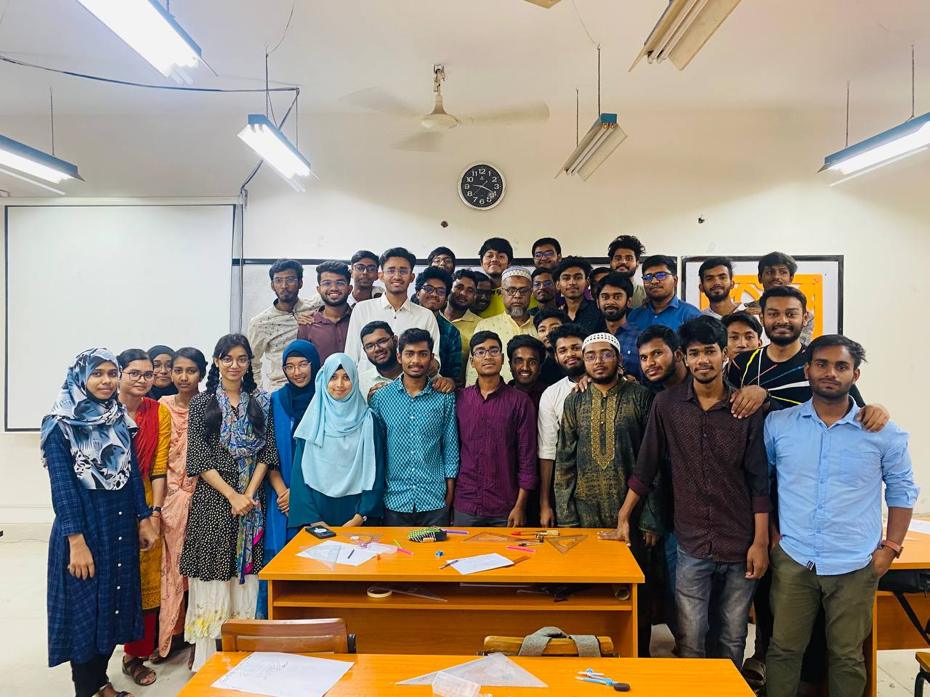
Future Enhancements
User Authentication: Implement login functionality for secure access.
Data Validation: Add validation checks for input fields to ensure data integrity.
Reporting: Generate reports on student demographics, performance, etc.
Integration: Integrate with other systems like attendance tracking or grading systems.

Slide 10
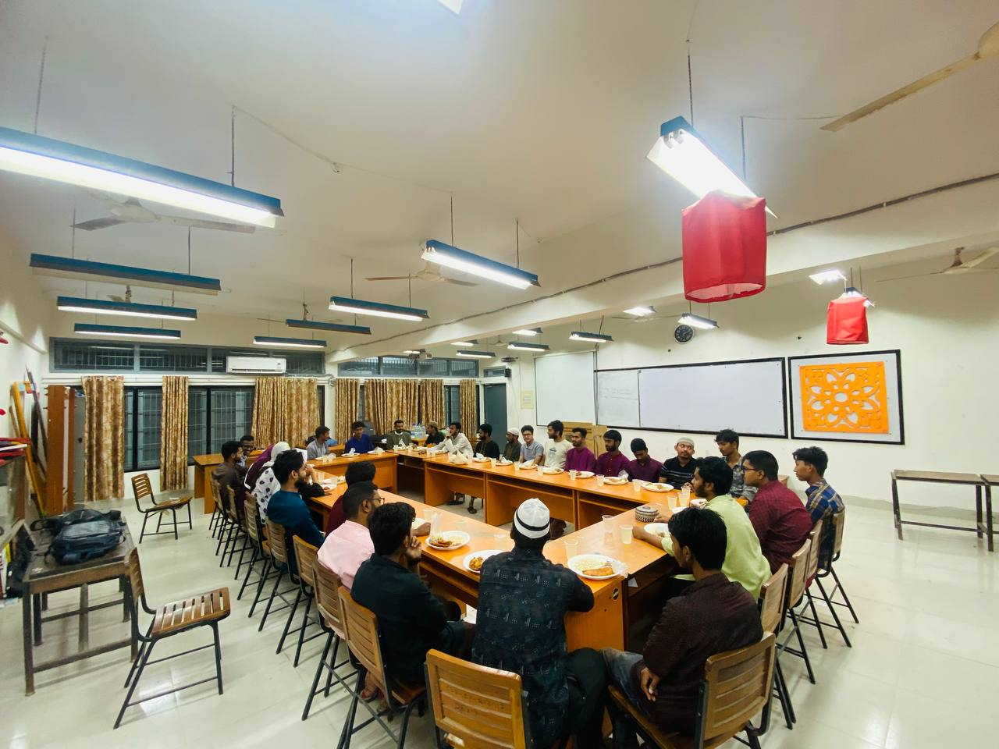
Conclusion
Summary: The Student Management System offers a user-friendly solution for managing student records efficiently.
Future Outlook: Continuous improvements and enhancements will further enhance its utility and effectiveness.

Slide 11

THANK YOU

